Slide 1
EDA Assignment 6 Part 1
5420 Anomaly Detection, Fall 2020
- Harsh Dhanuka, hd2457

Slide 2
5420 Anomaly Detection, Fall 2020
- Harsh Dhanuka, hd2457
Considerations
Heatmap for multi-collinearity
1. Revised 2 features
Grouped the ‘Sum total of Total Discharged’ by Provider Name, and State
‘Median Score by Provider’ grouped by the Provider Name, and State
2. Drop 7 variables with high multi-collinearity
3. Split to train_test:
- 75% split, train has 75% of the data.
- Now, for the test data, I will be using the entire 100% data, as even the train data has anomalies.

Slide 3
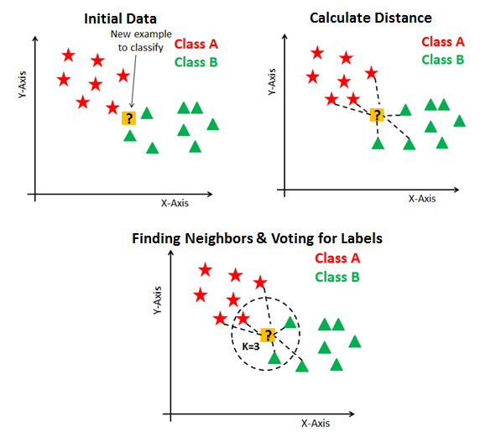
kNN Clustering
KNN represents a classification algorithm that will give new data points accordingly to the k number or the closest data points, while k-means clustering is an unsupervised clustering algorithm that gathers and groups data into k number of clusters.
In k-NN classification, the output is a class membership. An object is classified by a plurality vote of its neighbors, with the object being assigned to the class most common among its k nearest neighbors (k is a positive integer, typically small). If k = 1, then the object is simply assigned to the class of that single nearest neighbor.
k-NN is a type of instance-based learning, or lazy learning, where the function is only approximated locally and all computation is deferred until function evaluation.

Slide 4
5420 Anomaly Detection, Fall 2020
- Harsh Dhanuka, hd2457
kNN Clustering
3
Reasonable Boundaries
1
Model
I will chose 3 different cut points, which are:
0.0
1.0
5.0
This will result in a 4 cluster analysis.
Build initial model, and check stability by using the ‘Average’ aggregate method
2
Scores
The average scores go from -0.5 to 120. So, I make a subset with scores less than 4.0 to visualize better.

Slide 5
5420 Anomaly Detection, Fall 2020
- Harsh Dhanuka, hd2457
kNN Clustering
4
Clusters
Check the statistics of the 4 clusters.
Here, I am showing the percentage of data points in each cluster

Slide 6
5420 Anomaly Detection, Fall 2020
- Harsh Dhanuka, hd2457
Cluster Evaluation
Cluster wise variable Averages
5
Cluster 3 and 4 have less than 5% of the total data points
Out of these two clusters, cluster 4 has extremes or high standard deviation from mean for some variables, and hence, I will consider this cluster as suspicious.
Feature-wise cluster EDA will be imperative to justify this claim.
On the right, I evaluate a feature ‘Median Score’

Slide 7
5420 Anomaly Detection, Fall 2020
- Harsh Dhanuka, hd2457
Business Insight
6
Scores
y-by-average-score gives us insights about the clusters which are anomalies, as the anomalies might have a very high score compared to others.
I see that cluster 4 has a score almost 13-14 times higher than all other clusters. So, I can safely conclude that Cluster 4 is highly suspicious.
So, I would pass on the 256 specific entries of the Cluster 4 to the relevant authorities, and call for further investigation on each of the entries, to understand of they are true anomalies. I will provide all the reasoning as I have highlighted above, as to the differences in the means, and walk through the process I have done.

Slide 8
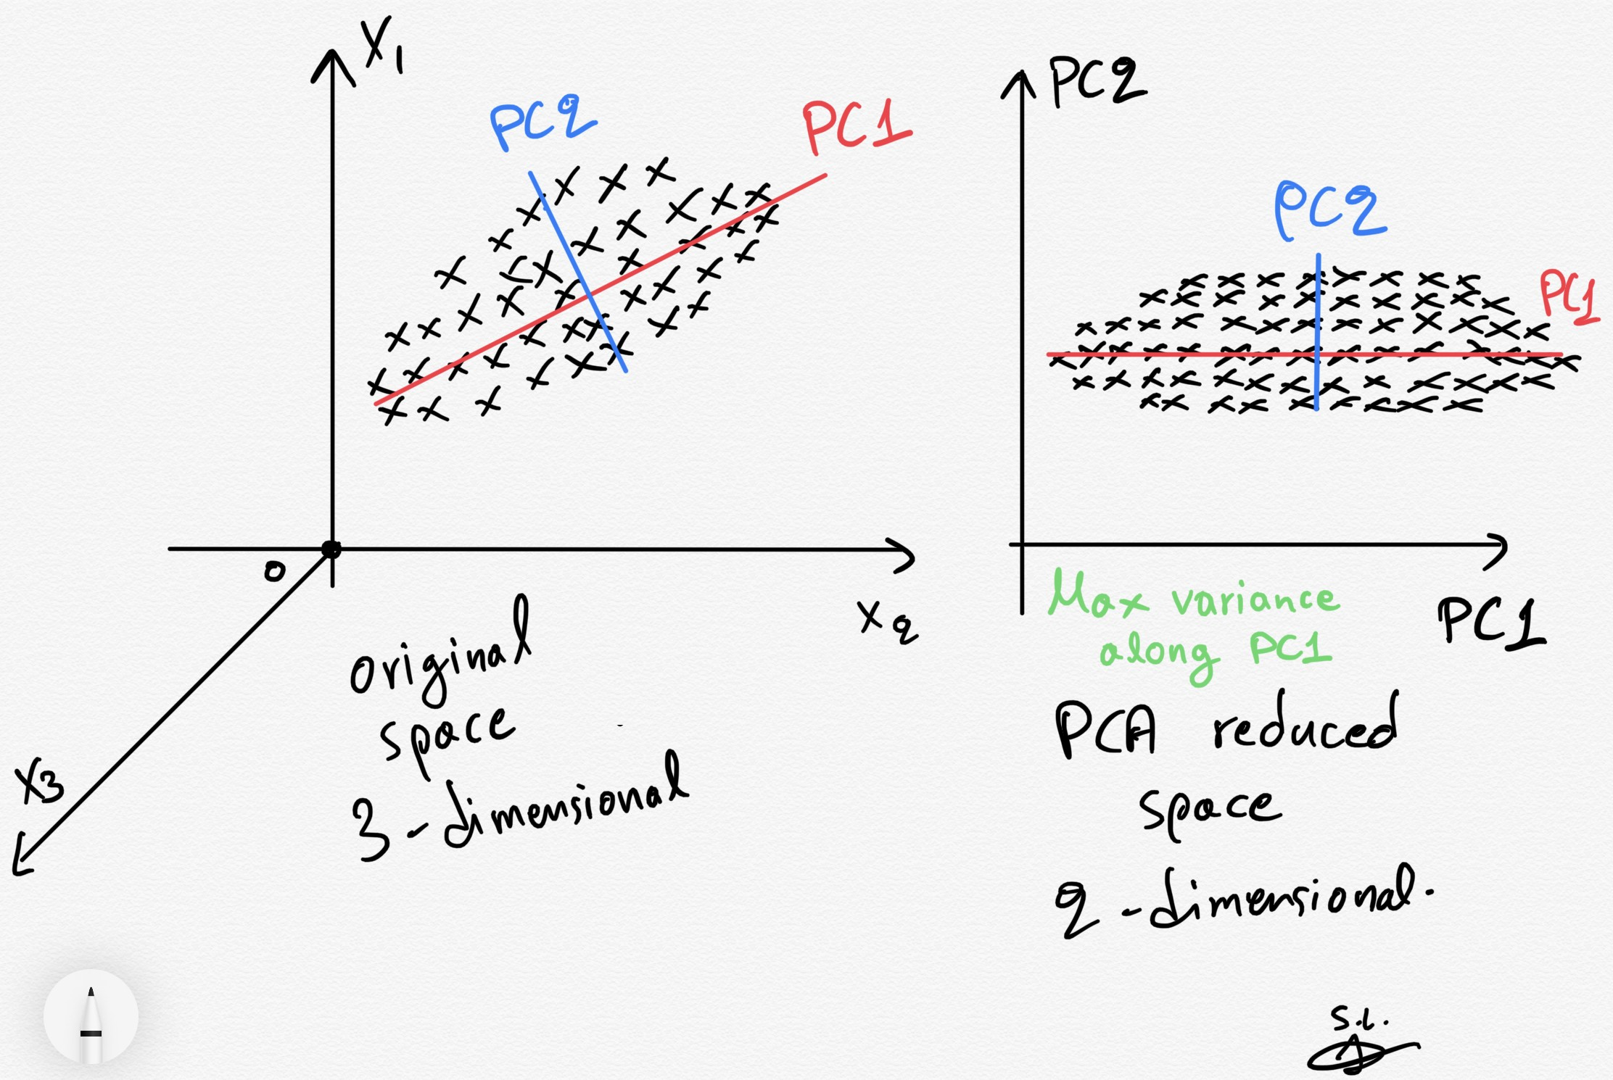
PCA Clustering
Principal component analysis (PCA) is the process of computing the principal components and using them to perform a change of basis on the data, sometimes using only the first few principal components and ignoring the rest.
PCA is used in exploratory data analysis and for making predictive models. It is commonly used for dimensionality reduction by projecting each data point
onto only the first few principal components to obtain lower-dimensional data while preserving as much of the data's variation as possible. The first principal component can equivalently be defined as a direction that maximizes the variance of the projected data. The ith principal component can be taken as a direction orthogonal to the first i−1 principal components that maximizes the variance of the projected data.

Slide 9
5420 Anomaly Detection, Fall 2020
- Harsh Dhanuka, hd2457
PCA Clustering
3
Reasonable Boundaries
1
Model
I will chose 3 different cut points, which are:
0.0
1.0
5.0
This will result in a 4 cluster model.
Build initial model, and check stability by using the ‘Average’ aggregate method
2
Scores
The scores go from -0.1 to 70. So I make a subset of scores less than 4.0 to visualize better.

Slide 10
5420 Anomaly Detection, Fall 2020
- Harsh Dhanuka, hd2457
PCA Clustering
4
Clusters
Check the statistics of the 4 clusters.
Here, I am showing the percentage of data points in each cluster

Slide 11
5420 Anomaly Detection, Fall 2020
- Harsh Dhanuka, hd2457
Cluster Evaluation
Cluster wise variable Averages
5
Cluster 2, 3 and 4 have less than 5% of the total data points
Out of these three clusters, cluster 4 has extremes or high standard deviation from mean for some variables, and hence, I will consider this cluster as suspicious.
Feature-wise cluster EDA will be imperative to justify this claim.
On the right, I evaluate a feature ‘Out of Pocket Payment’

Slide 12
5420 Anomaly Detection, Fall 2020
- Harsh Dhanuka, hd2457
Business Insight
6
Scores
y-by-average-score gives us insights about the clusters which are anomalies, as the anomalies might have a very high score compared to others.
I see that cluster 4 has a score almost 9 times higher than all other clusters. So, I can safely conclude that Cluster 4 is highly suspicious.
So, I would pass on the 638 specific entries of the Cluster 4 to the relevant authorities, and call for further investigation on each of the entries, to understand of they are true anomalies. I will provide all the reasoning as I have highlighted above, as to the differences in the means, and walk through the process I have done.

